Slide 1
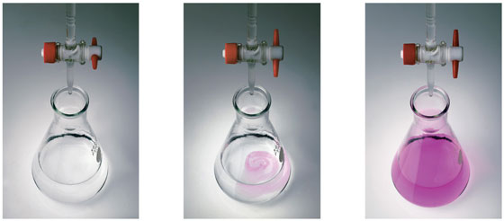
CHE 101: Introduction to Chemistry
Content: Acid Base Titration

Slide 2
Titration
The process in which the unknown concentration of a solution is determined by measuring the volume of a standard solution required to react completely with a definite volume of the solution of unknown concentration using suitable indicator is called titration.
The solution with known concentration is called standard solution.
Acid-base titration
Acid base titration involves adding an acid solution from a burette into a conical flask containing an alkaline solution in a controlled manner. Out of these two solutions the concentration of one solution is known and the concentration of another solution is to be determined. The point at which the acid solution completely neutralizes the alkali solution is called end point. A substance known as indicator usually used to determine the end point of acid-base titration. The indicator indicates the end point by changing the colour of the solution.

Slide 3
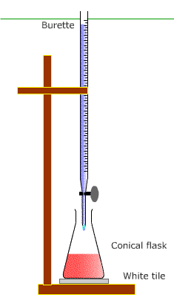
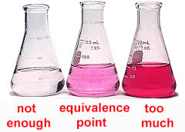

Slide 4
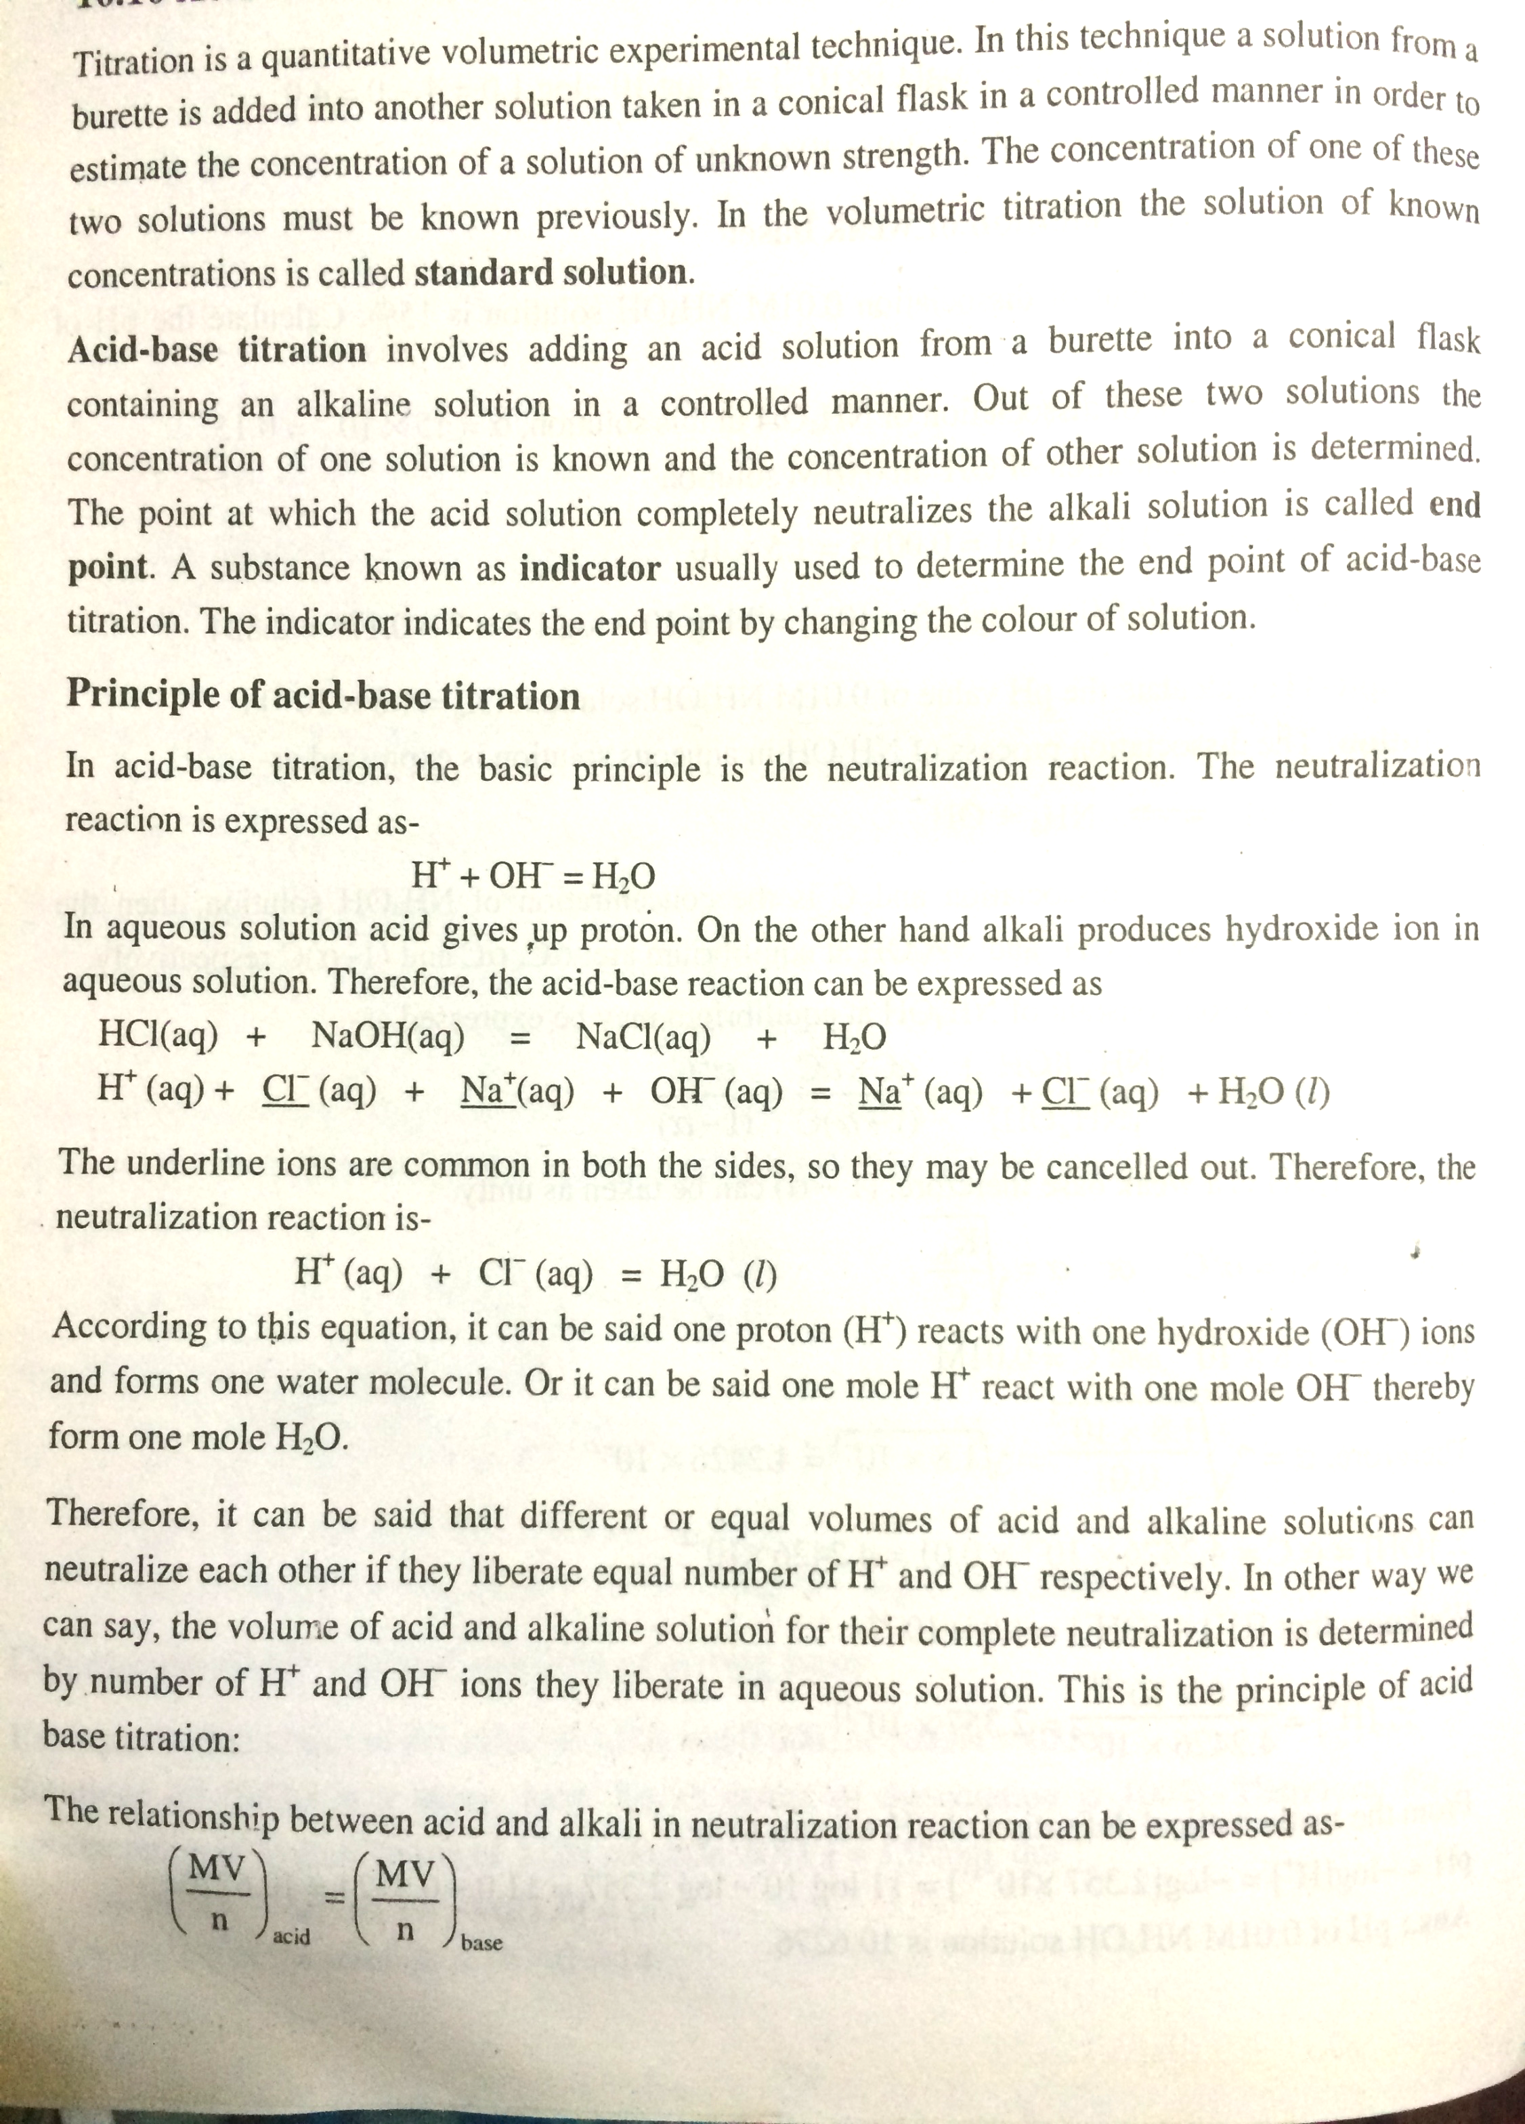
Principle of acid-base titration
H⁺ (aq) + OH⁻ (aq) = H₂O (l)

Slide 5
Principle of acid-base titration
The relationship between acid and alkali in neutralization reaction can be expressed as follows:
n_{b}M_{a}V_{a} = n_{a}M_{b}V_{b}
Here,
M_{a} = conc. of acid solution in molarity
V_{a} = volume of acid solution in cm³
n_{a} = number of moles of acid taken part in neutralization reaction (as expressed in the balanced equation)
M_{b} = conc. Of alkali solution in molarity
V_{b}= volume of alkali solution in cm³
n_{b} = number of moles of alkali taken part in neutralization reaction (as expressed in the balanced equation)

Slide 6
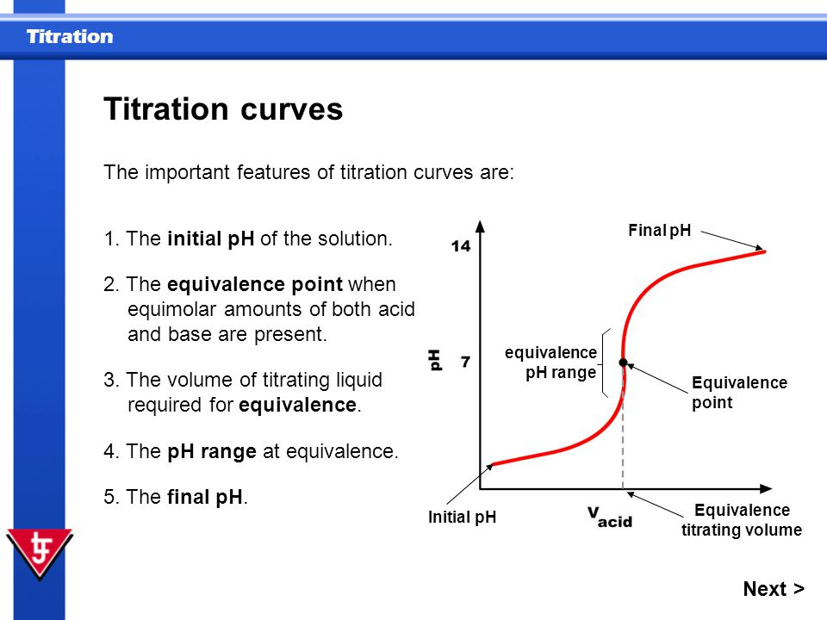

Slide 7
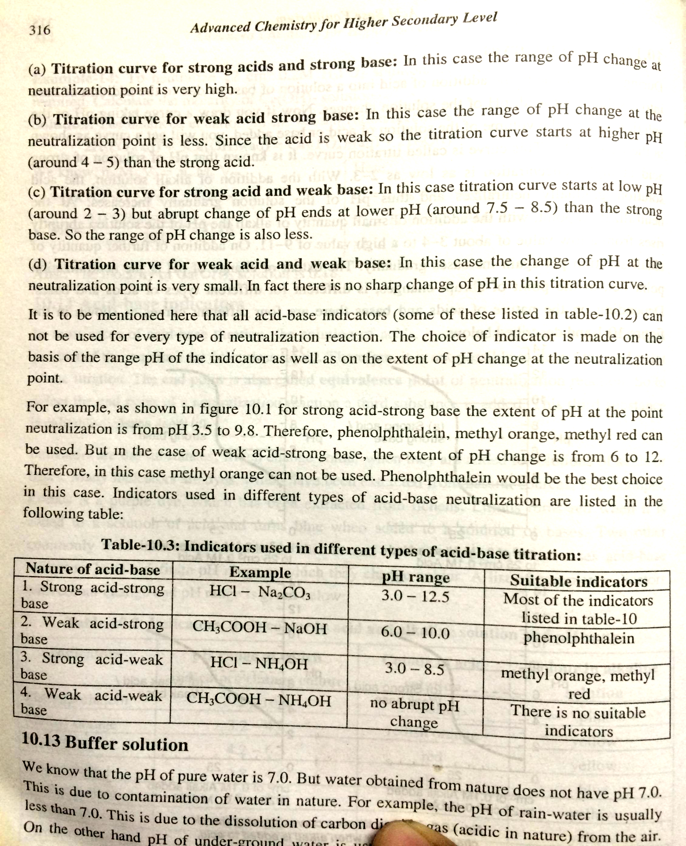
Nature of Titration Curves
Reference: https://www.khanacademy.org/test-prep/mcat/chemical-processes/titrations-and-solubility-equilibria/a/acid-base-titration-curves

